Slide 1
NOSQL

Slide 2
Aggregate data models
A data model is the model through which we perceive and manipulate our data.
For people using a database, the data model describe how we interact with the data in the database.
Data model : the model by which the database organizes data.
Notes:
A collection of conceptual tools for describing:
Data , Data relationships, Data semantics, Consistency constraints

Slide 3
The dominant data model of the last couple of decades is the relational data model, which is best visualized as a set of tables.
Each table has rows, with each row representing some entity of interest.
We describe this entity through columns, each having a single value(atomic value).
A column may refer to another row in the different table, which constitutes a relationship between those entities. (Foreign Key)

Slide 4
Aggregates
The relational model takes the information that we want to store and divides it into tuples (rows).
A tuple is a limited data structure: It captures a set of values, so we cannot nest one tuple within another to get nested records, nor can we put a list of values or tuples within another.
Aggregate orientation takes a different approach.
We often want to operate on data in units that have a more complex structure than a set of tuples.
key-value, document, and column-family databases all make use of this more complex record

Slide 5
However, there is no common term for this complex record; here (we) use the term “ aggregate.”
aggregate is a collection of related objects that we wish to treat as a unit.
In particular, it is a unit for data manipulation and management of consistency.
Aggregates are also often easier for application programmers to work with, since they often manipulate data through aggregate structures.

Slide 6
NoSQL
NoSQL is a non-relational database management systems, different from traditional relational database management systems in some significant ways.
It is designed for distributed data stores where very large scale of data storing needs.
For example Google or Facebook which collects terabits of data every day for their users.
These type of data storing may not require fixed schema, avoid join operations and typically scale horizontally.
Notes:
Horizontal scaling (aka scaling out) refers to adding additional nodes or machines to your infrastructure to cope with new demands. If you are hosting an application on a server and find that it no longer has the capacity or capabilities to handle traffic, adding a server may be your solution.
Vertical Scaling
While horizontal scaling refers to adding additional nodes, vertical scaling describes adding more power to your current machines. For instance, if your server requires more processing power, vertical scaling would mean upgrading the CPUs. You can also vertically scale the memory, storage, or network speed.

Slide 7
RDBMS
Structured and organized data
Structured query language (SQL)
Data and its relationships are stored in separate tables.
Data Manipulation Language, Data Definition Language
Tight Consistency

Slide 8
NoSQL
Stands for Not Only SQL
No predefined schema
Key-Value pair storage, Column Store, Document Store, Graph databases
Eventual consistency rather ACID property
Unstructured and unpredictable data
All NoSQL offerings relax one or more of the ACID properties (will talk about the CAP theorem)

Slide 9
NoSQL Categories
There are four general types (most common categories) of NoSQL databases.
Each of these categories has its own specific attributes and limitations.
There is not a single solutions which is better than all the others, however there are some databases that are better to solve specific problems.
Key-value stores
Column-oriented
Document oriented
Graph database

Slide 10
Key-value stores
Key-value stores are most basic types of NoSQL databases.
Designed to handle huge amounts of data (Based on Amazon’s Dynamo paper ).
Key value stores allow developer to store schema-less data.
In the key-value storage, database stores data as hash table where each key is unique and the value can be string, JSON etc.
For example a key-value pair might consist of a key like "Name" that is associated with a value like "Robin".
Use Cases :
Key-Values stores would work well for shopping cart contents.
Customized ad delivery to users based on their data profile
Example of Key-value store DataBase : Redis, DynamoDB, Riak. etc.
Notes:
Shopping cart
During the holiday shopping season, an e-commerce website may receive billions of orders in seconds. Key-value databases can handle the scaling of large amounts of data and extremely high volumes of state changes while servicing millions of simultaneous users through distributed processing and storage. Key-value databases also have built-in redundancy, which can handle the loss of storage nodes.
Session store
A session-oriented application such as a web application starts a session when a user logs in and is active until the user logs out or the session times out. During this period, the application stores all session-related data either in the main memory or in a database. Session data may include user profile information, messages, personalized data and themes, recommendations, targeted promotions, and discounts. Each user session has a unique identifier. Session data is never queried by anything other than a primary key, so a fast key-value store is a better fit for session data. In general, key-value databases may provide smaller per-page overhead than relational databases.

Slide 11
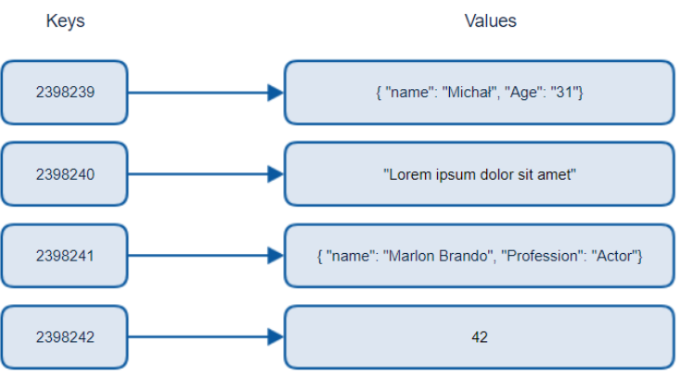
The application is developed on queries that are based on keys.
Implements a hash table to store unique keys along with the pointers to the corresponding data values.
Have no query language but they do provide a way to add and remove key-value pairs. Search only based on Key
Notes:
This type of NoSQL database implements a hash table to store unique keys along with the pointers to the corresponding data values. The values can be of scalar data types such as integers or complex structures such as JSON, lists, BLOB, and so on. A value can be stored as an integer, a string, JSON, or an array—with a key used to reference that value. It typically offers excellent performance and can be optimized to fit an organization’s needs. Key-value stores have no query language but they do provide a way to add and remove key-value pairs. Values cannot be queried or searched upon. Only the key can be queried.

Slide 12
Column-oriented databases
Most databases have a row as a unit of storage which, in particular, helps write performance.
However, there are many scenarios where writes are rare, but we often need to read a few columns of many rows at once for some analytics on those few columns.
In this situation, it’s better to store groups of columns for all rows as the basic storage unit—which is why these databases are called column stores.
Example of Column-oriented databases : BigTable, Hbase, Cassandra etc.
Notes:
So if someone wants to run analytics on a small number of columns, one can read those columns directly without consuming memory with the unwanted data. Columns are somehow are of the same type and gain from more efficient compression, which makes reads faster than before. Examples of Columnar Data Model: Cassandra and Apache Hadoop Hbase.

Slide 13
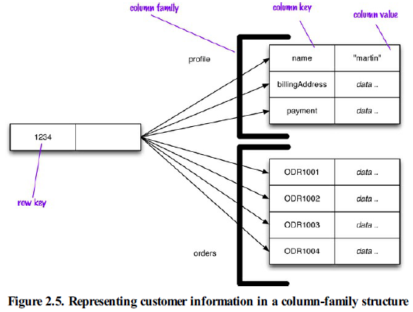
To get a particular customer’s name from Figure 2.5 we could do something like get('1234', 'name').

Slide 14
Document Oriented databases
A collection of documents
Data in this model is stored inside documents.
A document is a key value collection where the key allows access to its value.
Documents are not typically forced to have a schema and therefore are flexible and easy to change.
Documents can contain many different key-value pairs, or key-array pairs, or even nested documents.
Example of Document Oriented databases : MongoDB, CouchDB etc.
Notes:
These new database models are jointly referred to as NoSQL databases, as they usually do not use SQL.
NoSQL databases offer a high level of scalability as well as flexibility in terms of data structure.
These features make NoSQL databases useful for handling large volumes of data and fast-paced, agile development.

Slide 15
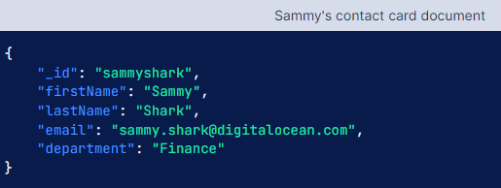
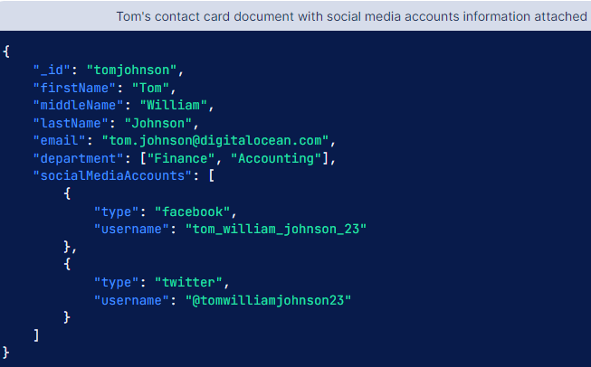
Notes:
Document databases store data as documents. You might think of a document as a self-contained data entry containing everything needed to understand its meaning, similar to documents used in the real world.

Slide 16
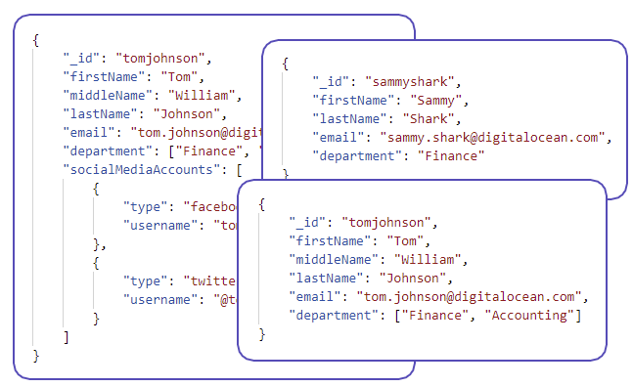
Collection
Notes:
Collection

Slide 17
Graph databases
A graph database stores data in a graph.
A graph database is a collection of nodes and edges
Each node represents an entity (such as a student or business) and each edge represents a connection or relationship between two nodes.
Every node and edge are defined by a unique identifier.
Each node knows its adjacent nodes.
Example of Graph databases : OrientDB, Neo4J, Titan. etc.

Slide 18
Graph databases are an odd fish in the NoSQL pond.
Graph databases are motivated by a different frustration with relational databases and thus have an opposite model—small records with complex interconnections, something like Figure below.
Notes:
Most NoSQL databases were inspired by the need to run on clusters, which led to aggregate-oriented data models of large records with simple connections.

Slide 19
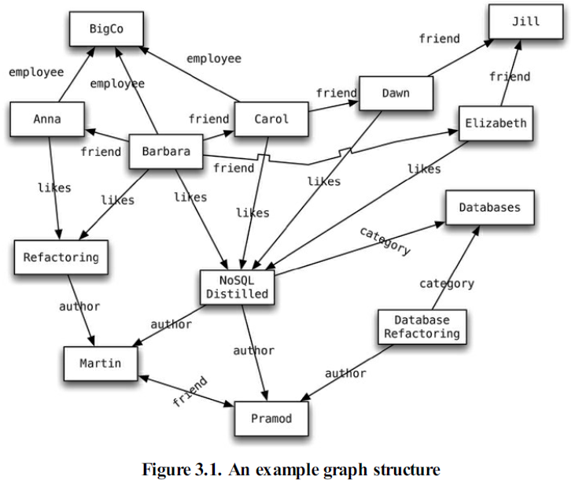

Slide 20
We refer to a graph data structure of nodes connected by edges.
In Figure we have a web of information whose nodes are very small (nothing more than a name) but there is a rich structure of interconnections between them.
With this structure, we can ask questions such as “ find the books in the Databases category that are written by someone whom a friend of mine likes.”

Slide 21
Brewer’s CAP Theorem
The CAP Theorem is a fundamental theorem in distributed systems that states any distributed system can have at most two of the following three properties.
Consistency ( C )
Availability ( A )
Partition tolerance ( P )
Consistency : Consistency means that all clients see the same data at the same time, no matter which node they connect to.
Availability : Availability means that that any client making a request for data gets a response, even if one or more nodes are down. Another way to state this—all working nodes in the distributed system return a valid response for any request, without exception.
Partition Tolerance : A partition is a communications break within a distributed system—a lost or temporarily delayed connection between two nodes. Partition tolerance means that the cluster must continue to work despite any number of communication breakdowns between nodes in the system.
Notes:
Availability:
Here's how Gilbert and Lynch describe availability.
every request received by a non-failing node in the system must result in a responseIn an available system, if our client sends a request to a server and the server has not crashed, then the server must eventually respond to the client. The server is not allowed to ignore the client's requests.

Slide 22
Brewer’s theorem is that in any given system, we can strongly support only two out of the three.
We have to choose between them because of this sliding mutual dependency.
The more consistency we demand from our system, for example, the less partition-tolerant we are likely to be able to make it, unless we make some concessions around availability.

Slide 23
In distributed systems, however, it is very likely that we will have network partitioning, and that at some point, machines will fail and cause others to become unreachable.
Packet loss, too, is nearly inevitable.
This leads us to the conclusion that a distributed system must do its best to continue operating in the face of network partitions (to be Partition-Tolerant), leaving us with only two real options to choose from: Availability and Consistency.

Slide 24
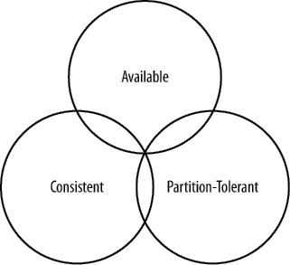
Figure . CAP Theorem indicates that we can realize only two of these properties at once

Slide 25
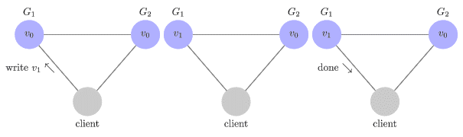
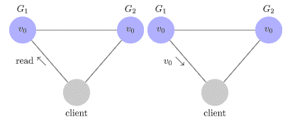
How distributed system work
Assume the system is composed of two servers, G1 and G2. Both of these servers are keeping track of the same variable, v , whose value is initially v0. G1 and G2 can communicate with each other and can also communicate with external clients.
write
Read
Notes:
https://mwhittaker.github.io/blog/an_illustrated_proof_of_the_cap_theorem/

Slide 26
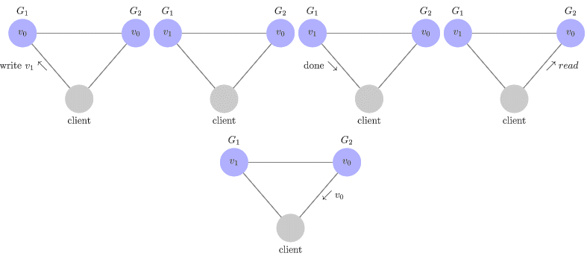
Inconsistency
Notes:
https://mwhittaker.github.io/blog/an_illustrated_proof_of_the_cap_theorem

Slide 27
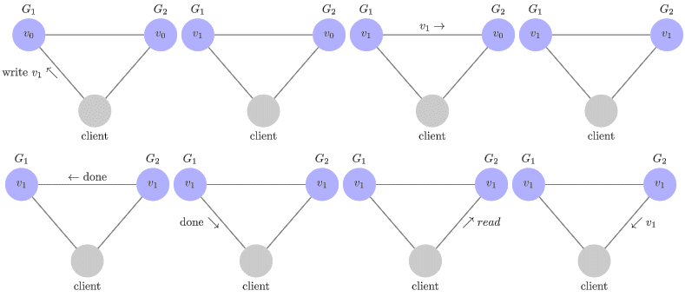
Consistency
Notes:
https://mwhittaker.github.io/blog/an_illustrated_proof_of_the_cap_theorem

Slide 28
Availability
every request received by a non-failing node in the system must result in a valid response
In an available system, if our client sends a request to a server and the server has not crashed, then the server must eventually respond to the client. The server is not allowed to ignore the client's requests.

Slide 29
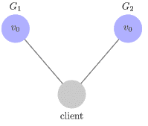
Partition Tolerance
Partition tolerance means that the cluster must continue to work despite any number of communication breakdowns between nodes in the system.
The network will be allowed to lose arbitrarily many messages sent from one node to another
This means that any messages G1 & G2 send to one another can be dropped. If all the messages were being dropped, then our system would look like this.

Slide 30
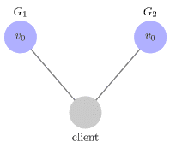
The Proof – By contradiction
Assume for contradiction that there does exist a system that is consistent, available, and partition tolerant (means some Servers may be disconnected due to network link failure).

Slide 31
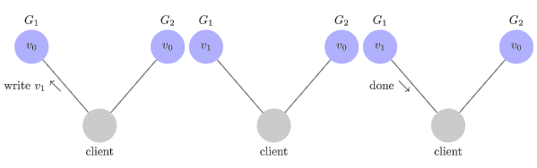
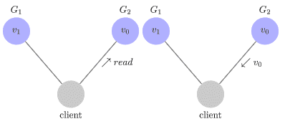
…The Proof – By contradiction
Notes:
we have our client request that v1v1 be written to G1G1. Since our system is available, G1G1 must respond. Since the network is partitioned, however, G1 cannot replicate its data to G2.
Next, we have our client issue a read request to G2G2. Again, since our system is available, G2G2 must respond. And since the network is partitioned, G2 cannot update its value from G1. It returns v0.

Slide 32
NoSQL databases are classified based on the two CAP characteristics they support:
CP :
Some data may not be accessible(Availability missing), but the rest is still consistent/accurate.
AP :
System is still available under portioning, but some of the data returned may be inaccurate(Consistency missing).
CA :
Single site cluster, therefore all nodes are always in contact, when partition occurs system block.
Relational databases they come under this category, deliver consistency and availability.
CA distributed database can be implemented if we deployed to multiple nodes using replication.
Notes:
CP database: A CP database delivers consistency and partition tolerance at the expense of availability. When a partition occurs between any two nodes, the system has to shut down the non-consistent node (i.e., make it unavailable) until the partition is resolved.
AP database: An AP database delivers availability and partition tolerance at the expense of consistency. When a partition occurs, all nodes remain available but those at the wrong end of a partition might return an older version of data than others. (When the partition is resolved, the AP databases typically resync the nodes to repair all inconsistencies in the system.)
CA database: A CA database delivers consistency and availability across all nodes. It can’t do this if there is a partition between any two nodes in the system, however, and therefore can’t deliver fault tolerance.
In a distributed system, partitions can’t be avoided, for all practical purposes, a CA distributed database can’t exist.
Many relational databases they come under this category, deliver consistency and availability.
CA distributed database can be implemented if we deployed to multiple nodes using replication.

Slide 33
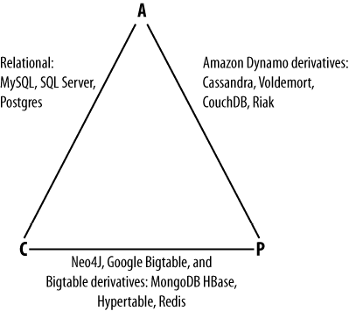
Figure shows the general focus of some of the different databases.
However, this does not mean that they dismiss Consistency as unimportant
Figure 1-2. Where different databases appear on the CAP continuum

Slide 34


Slide 35
MongoDB is an open-source document database and leading NoSQL database.
MongoDB is written in C++
MongoDB is a cross-platform, document oriented database that provides, high performance, high availability, and easy scalability.
MongoDB works on concept of collection and document.

Slide 36
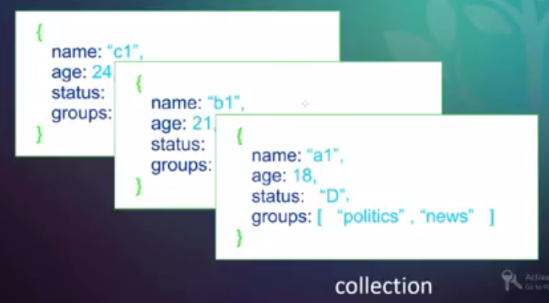
Document oriented storage

Slide 37
Database
Database is a physical container for collections.
Each database gets its own set of files on the file system.
A single MongoDB server typically has multiple databases.

Slide 38
Collection
Collection is a group of MongoDB documents.
It is the equivalent of an RDBMS table.
A collection exists within a single database.
Collections do not enforce a schema. Documents within a collection can have different fields.
Typically, all documents in a collection are of similar or related purpose.

Slide 39
Document
A document is a set of key-value pairs.
Documents have dynamic schema.
Dynamic schema means that documents in the same collection do not need to have the same set of fields or structure, and common fields in a collection's documents may hold different types of data.
Notes:
This type of database associates each document with a unique key that takes the form of a string, path or URI. Keys are used to locate and pull individual documents from the database.

Slide 40
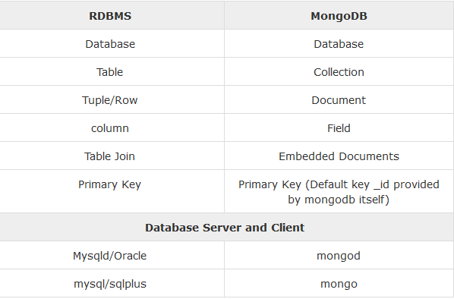

Slide 41
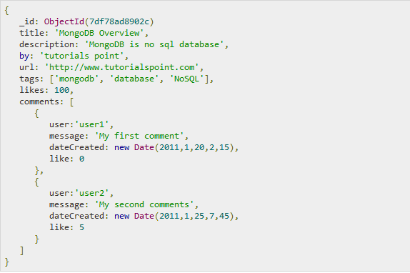
Following example shows the document structure of a blog site, which is simply a comma separated key value pair.

Slide 42
_id is a 12 bytes hexadecimal number which assures the uniqueness of every document.
We can provide _id while inserting the document.
If we don’t provide then MongoDB provides a unique id for every document.
These 12 bytes first 4 bytes for the current timestamp, next 3 bytes for machine id, next 2 bytes for process id of MongoDB server and remaining 3 bytes are simple incremental VALUE.

Slide 43
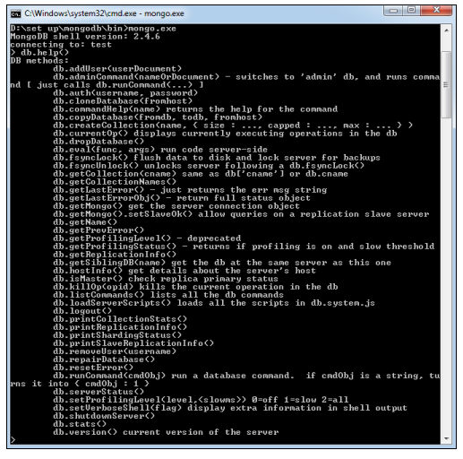
MongoDB Help
Db.help()
Notes:
Db.help()

Slide 44
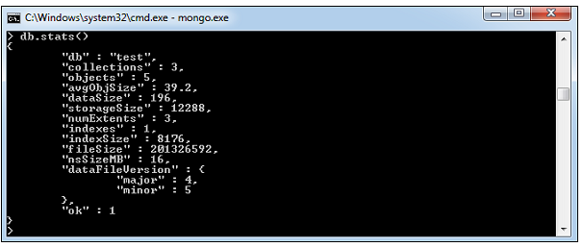
MongoDB Statistics
db.stats() : To get stats about MongoDB server.
This shows the database name, number of collection and documents in the database.

Slide 45
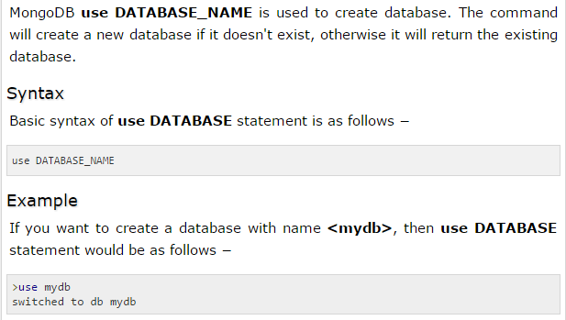
The use Command- Creating Database

Slide 46
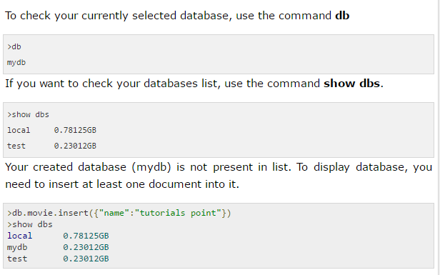
The use Command
In MongoDB default database is test. If you didn't create any database, then collections will be stored in test database.
Notes:
db

Slide 47
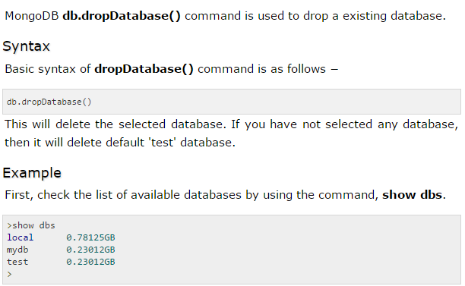
The dropDatabase() Method

Slide 48
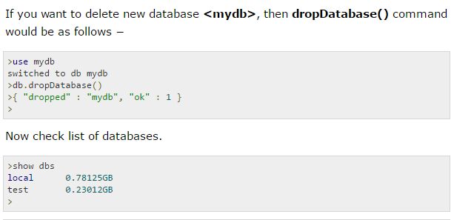
The dropDatabase() Method

Slide 49
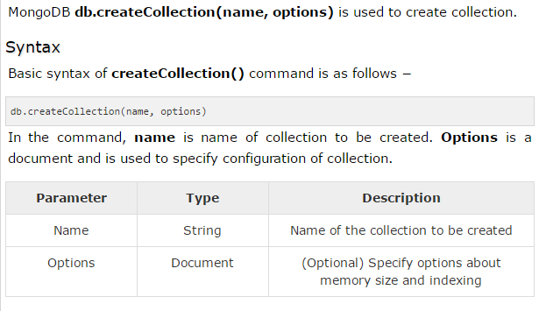
The createCollection() Method
Options parameter is optional

Slide 50
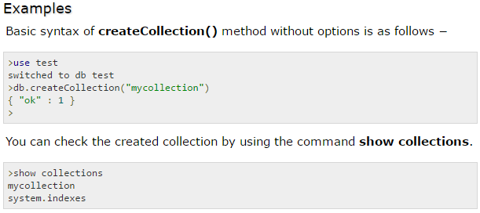

Slide 51
In MongoDB, we don't need to create collection. MongoDB creates collection automatically, when we insert some document.
>db.mitcollection.insert({"name" : “DSCA"})
>show collections
mycol
mycollection
system.indexes
mitcollection
>

Slide 52
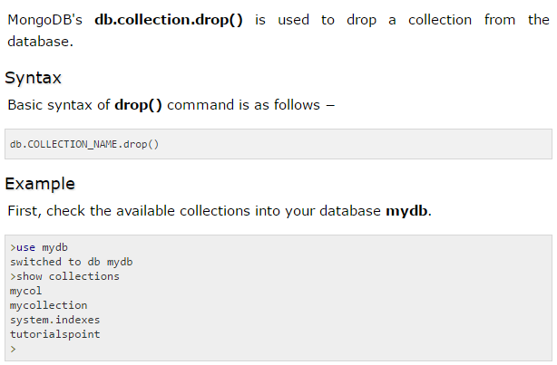
The drop() Method

Slide 53
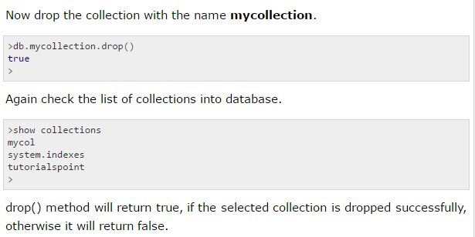

Slide 54
MongoDB - Datatypes
String
Integer
Boolean
Double
Arrays
Timestamp
Object.
And more

Slide 55
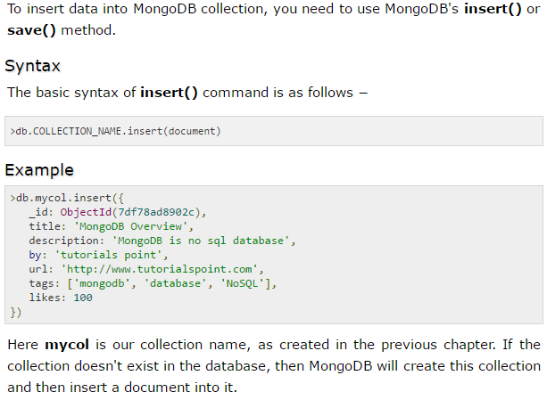
The insert() Method

Slide 56
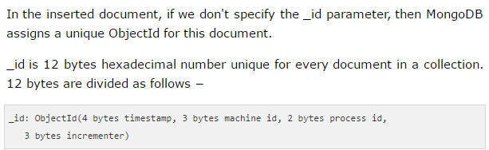

Slide 57
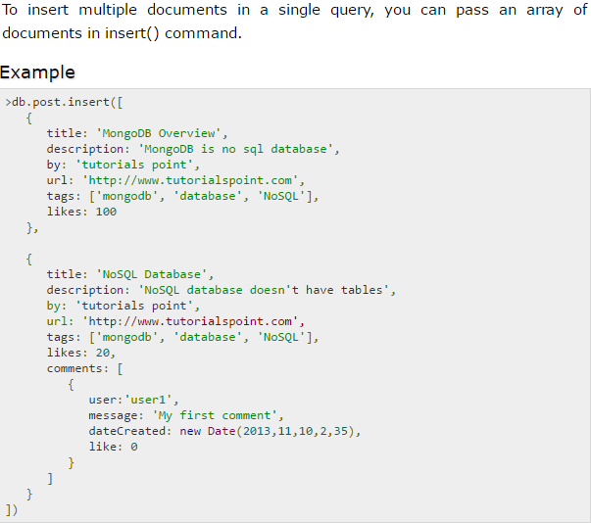

Slide 58
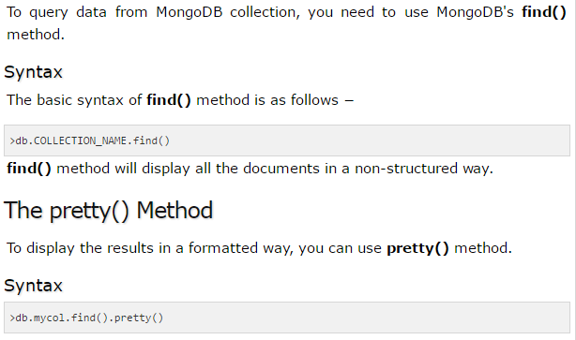
MongoDB - Query Document
The find() Method

Slide 59
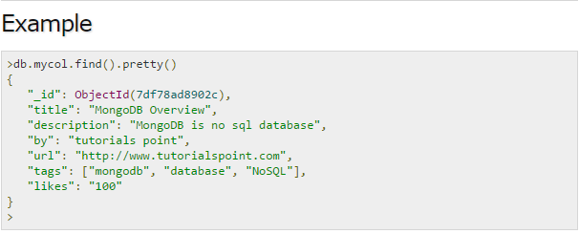

Slide 60
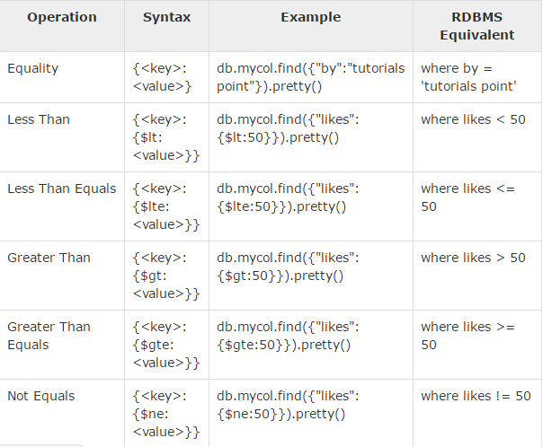
RDBMS Where Clause Equivalents in MongoDB

Slide 61
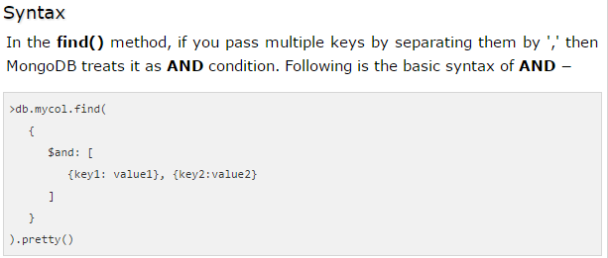
AND in MongoDB

Slide 62
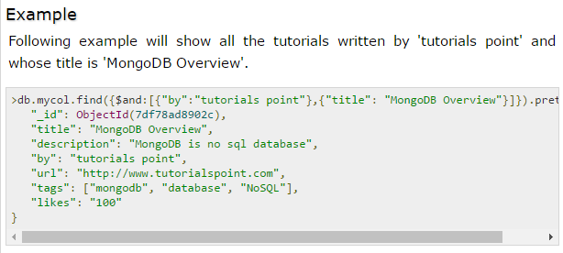

Slide 63
END

